Slide 1

Parcel-level land use and water quality impacts in the Santa Margarita River Watershed
Trent Biggs, Gabe Delatorre, Kaelynn Graham, Madison Ramos, & Dennis Quach

Slide 2
Purpose
“Provide enough materials to assist enforcement of water quality regulations”

Slide 3
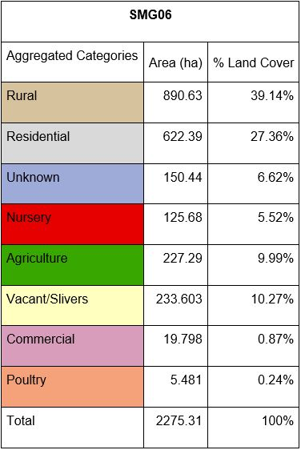
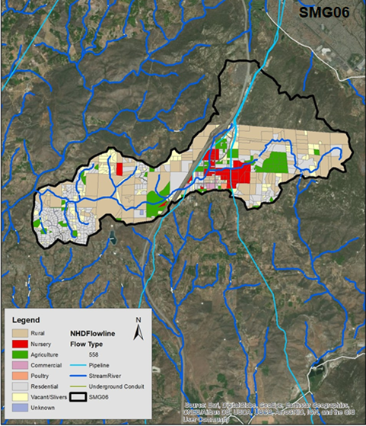

Slide 4
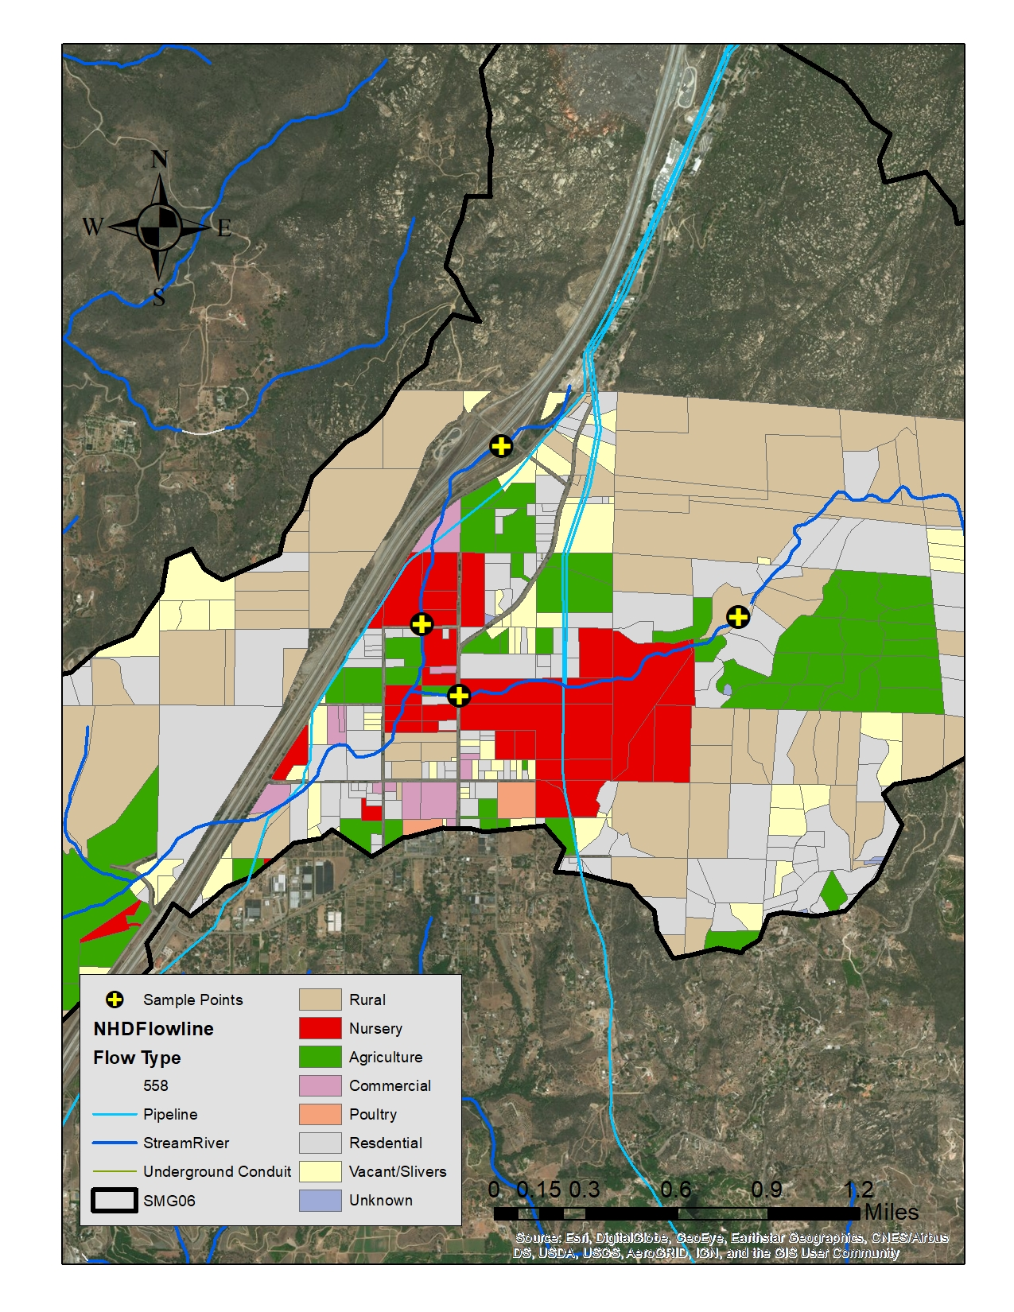
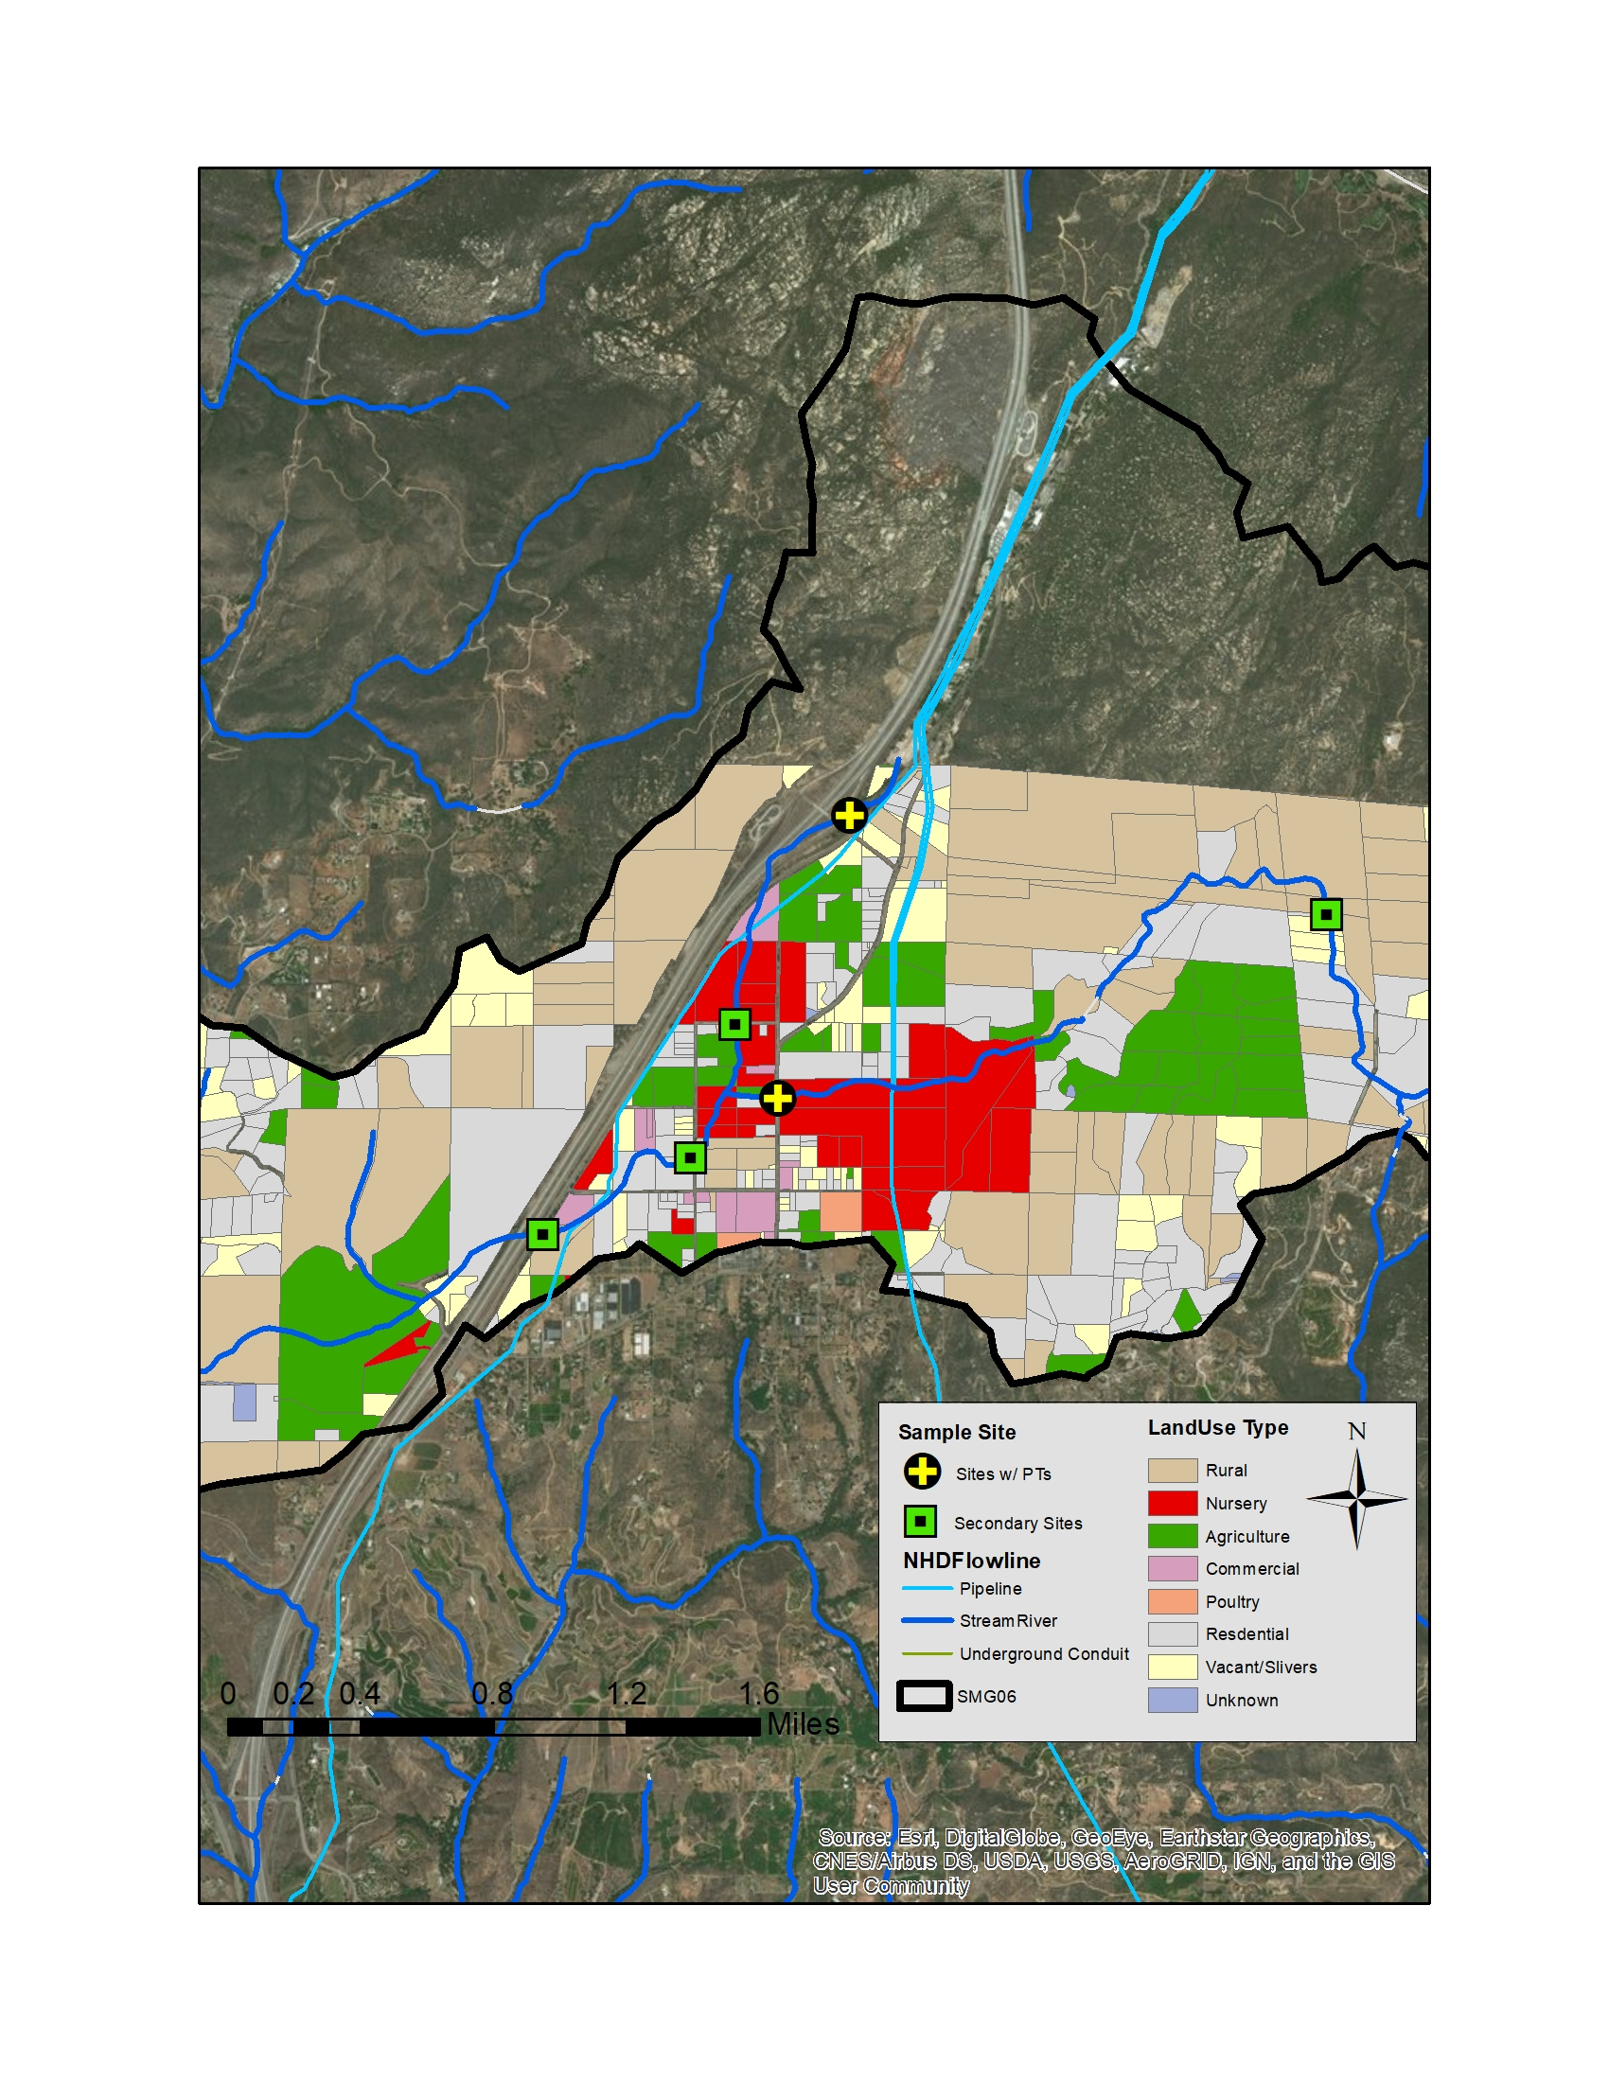
Original Proposed Sampling Sites
Finalized Sampling Sites

Slide 5
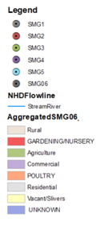
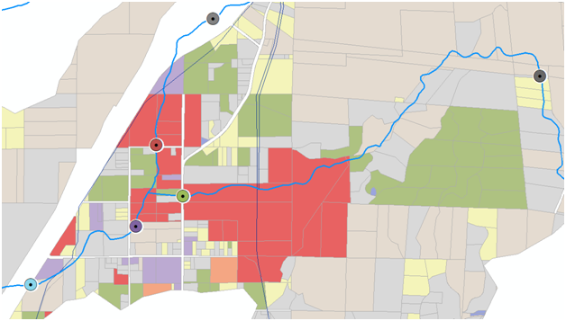
Methods
Sample Data Collection

Slide 6
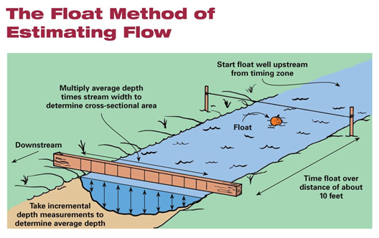
Methods
Discharge Measurements Avg depth x length (10ft) x width
Pressure Transducer installation to gauge water and air pressure
Source: https://polarpedia.eu/en/floating-method/

Slide 7
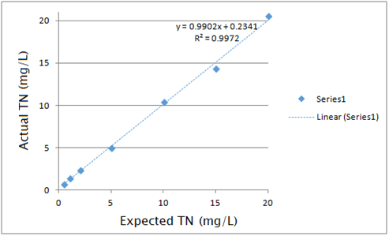
Methods
TN & TOC Analysis
The chemical analysis for total nitrogen (TN) and total organic carbon (TOC) was performed using a series of varying standards for the chemicals relatively ranging from 0.5 to 5 for TN and 0.5 to 20 for TC.
Phosphorus Analysis
Phosphate was analyzed using series of varying standards for the chemicals ranging from 0.02ppm to 0.5ppm of phosphate.
Trendline of standards expected values vs. actual values used to correct TN and TOC results

Slide 8
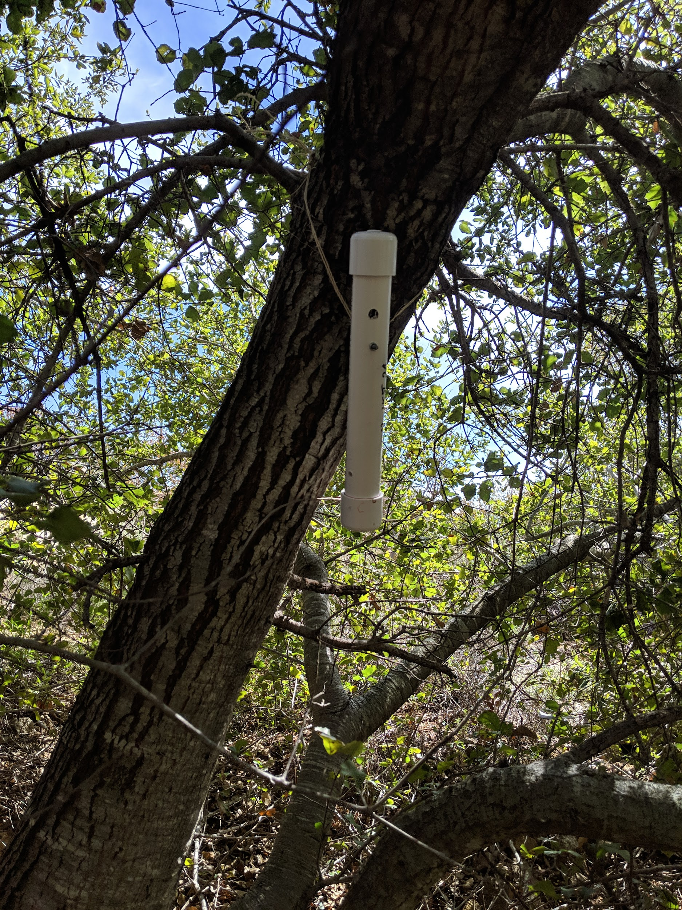
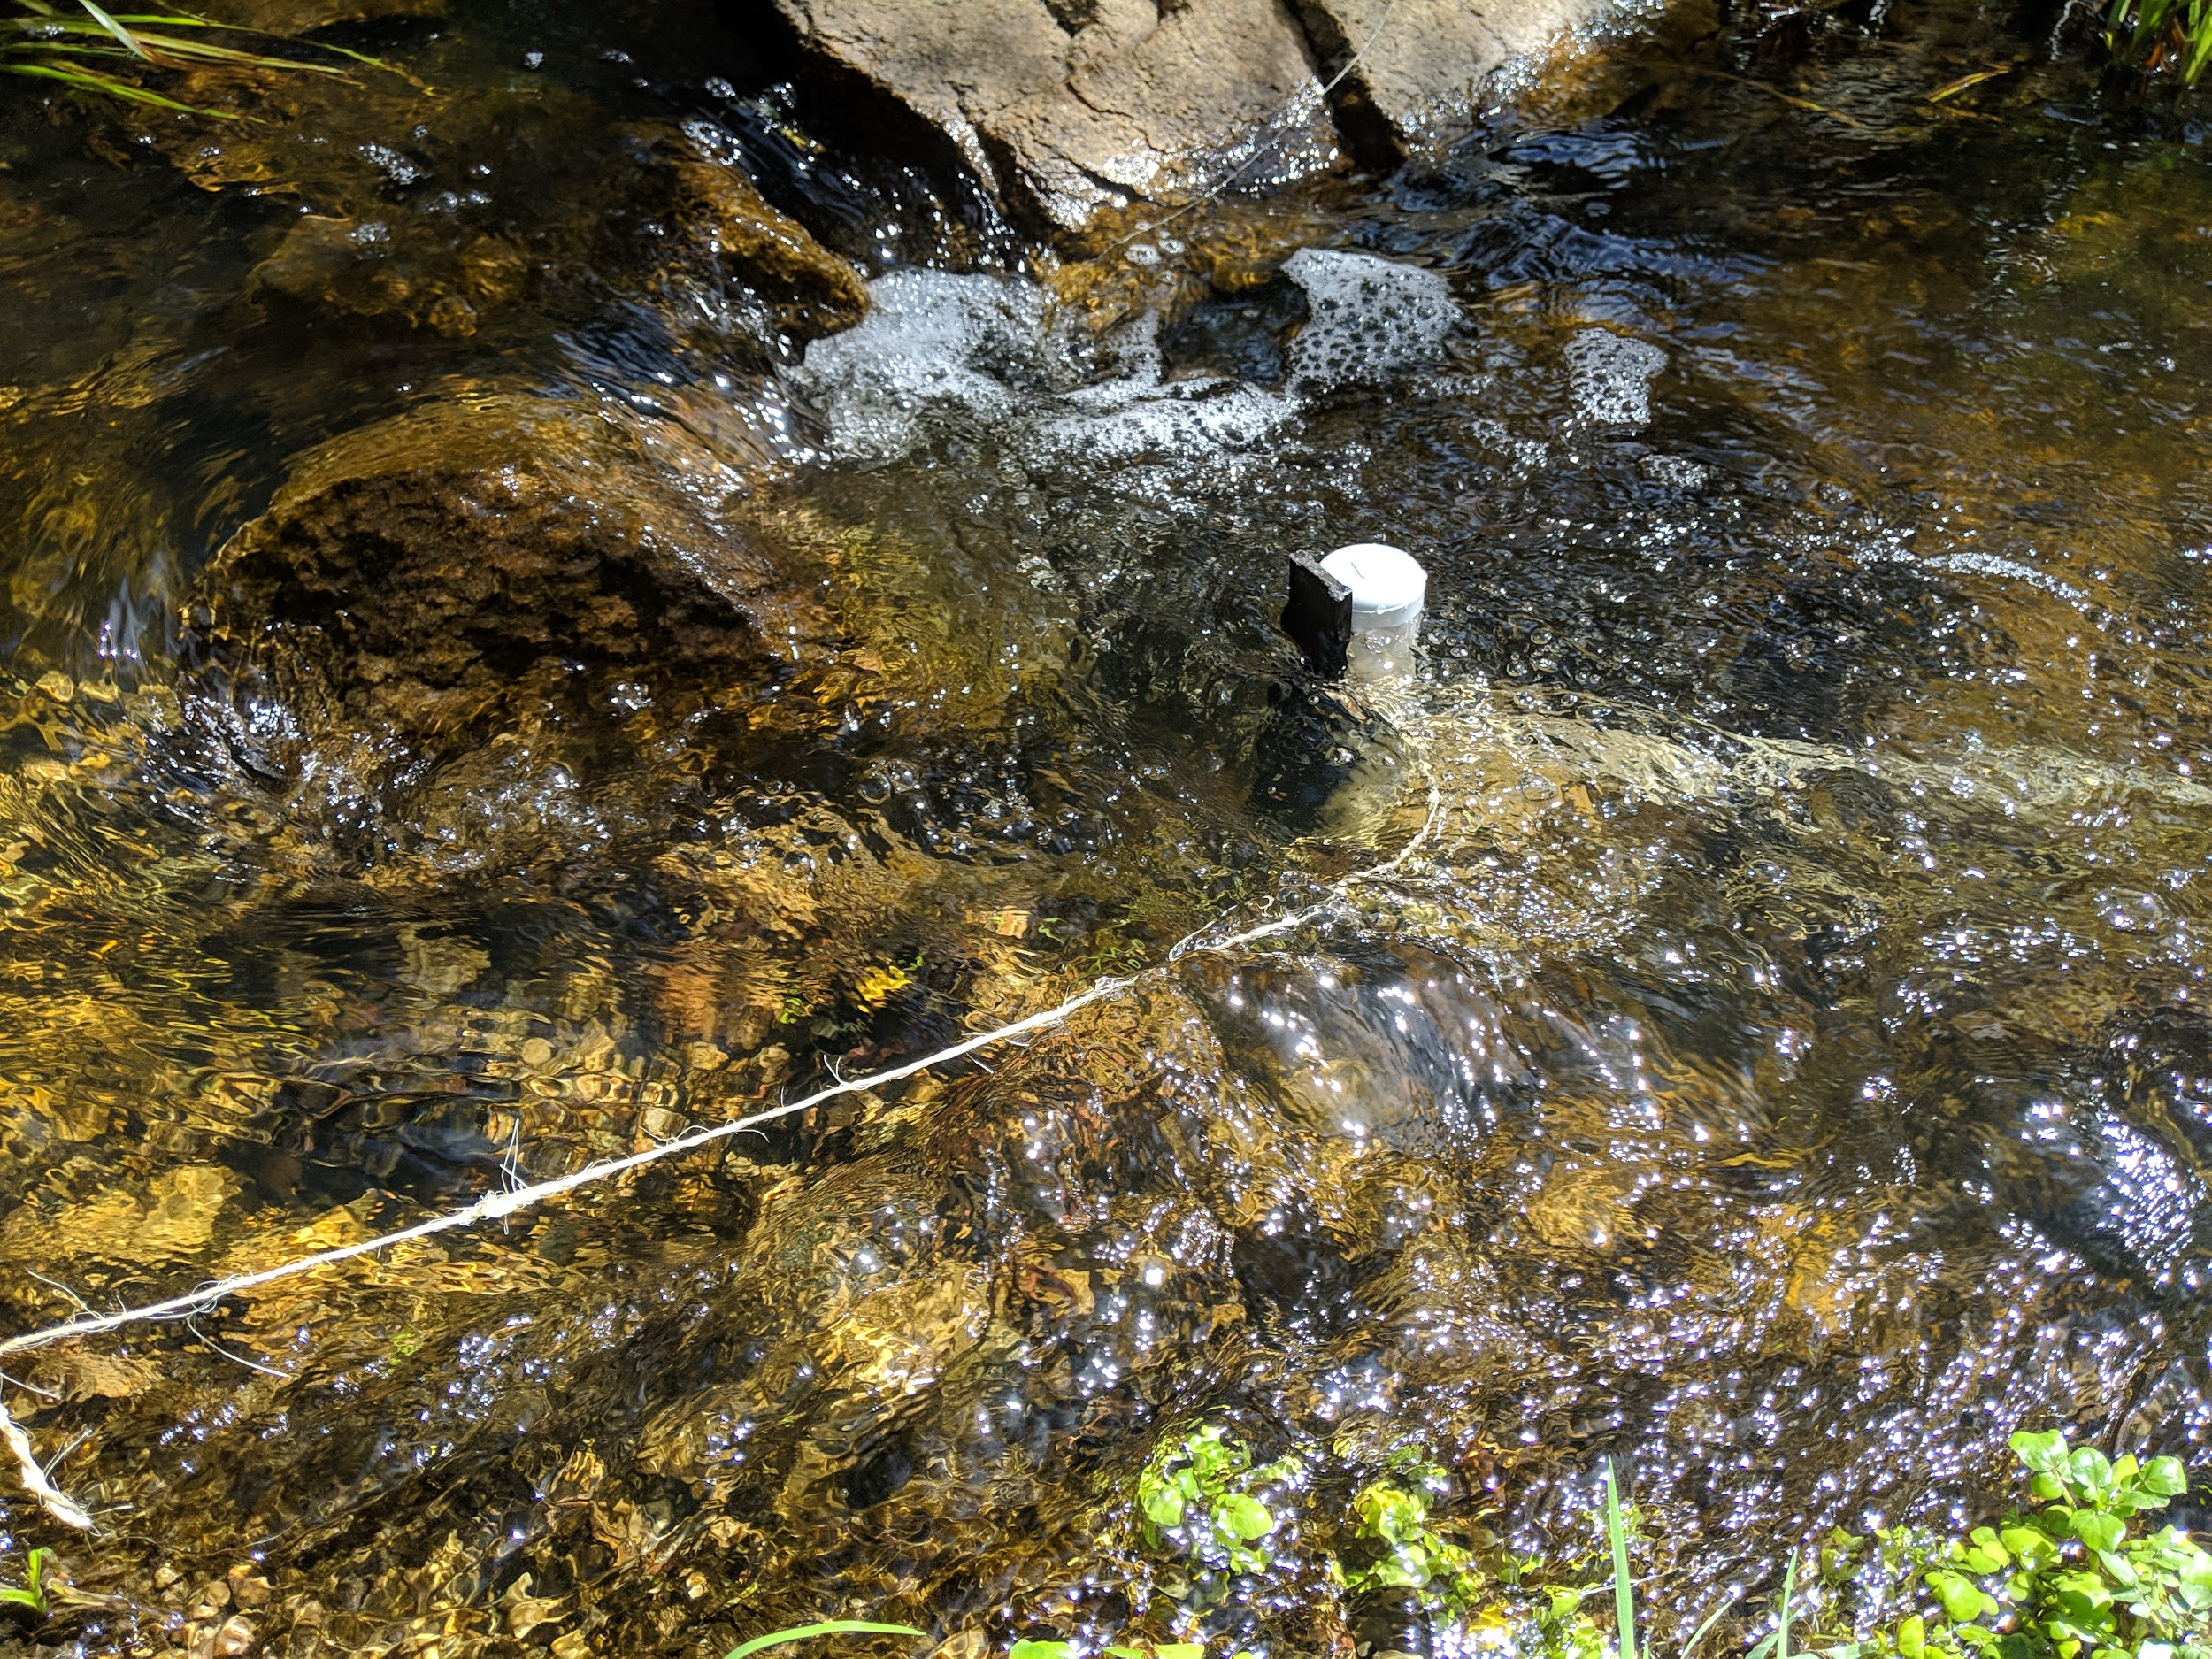
Pressure Transducers 1A & 2A

Slide 9
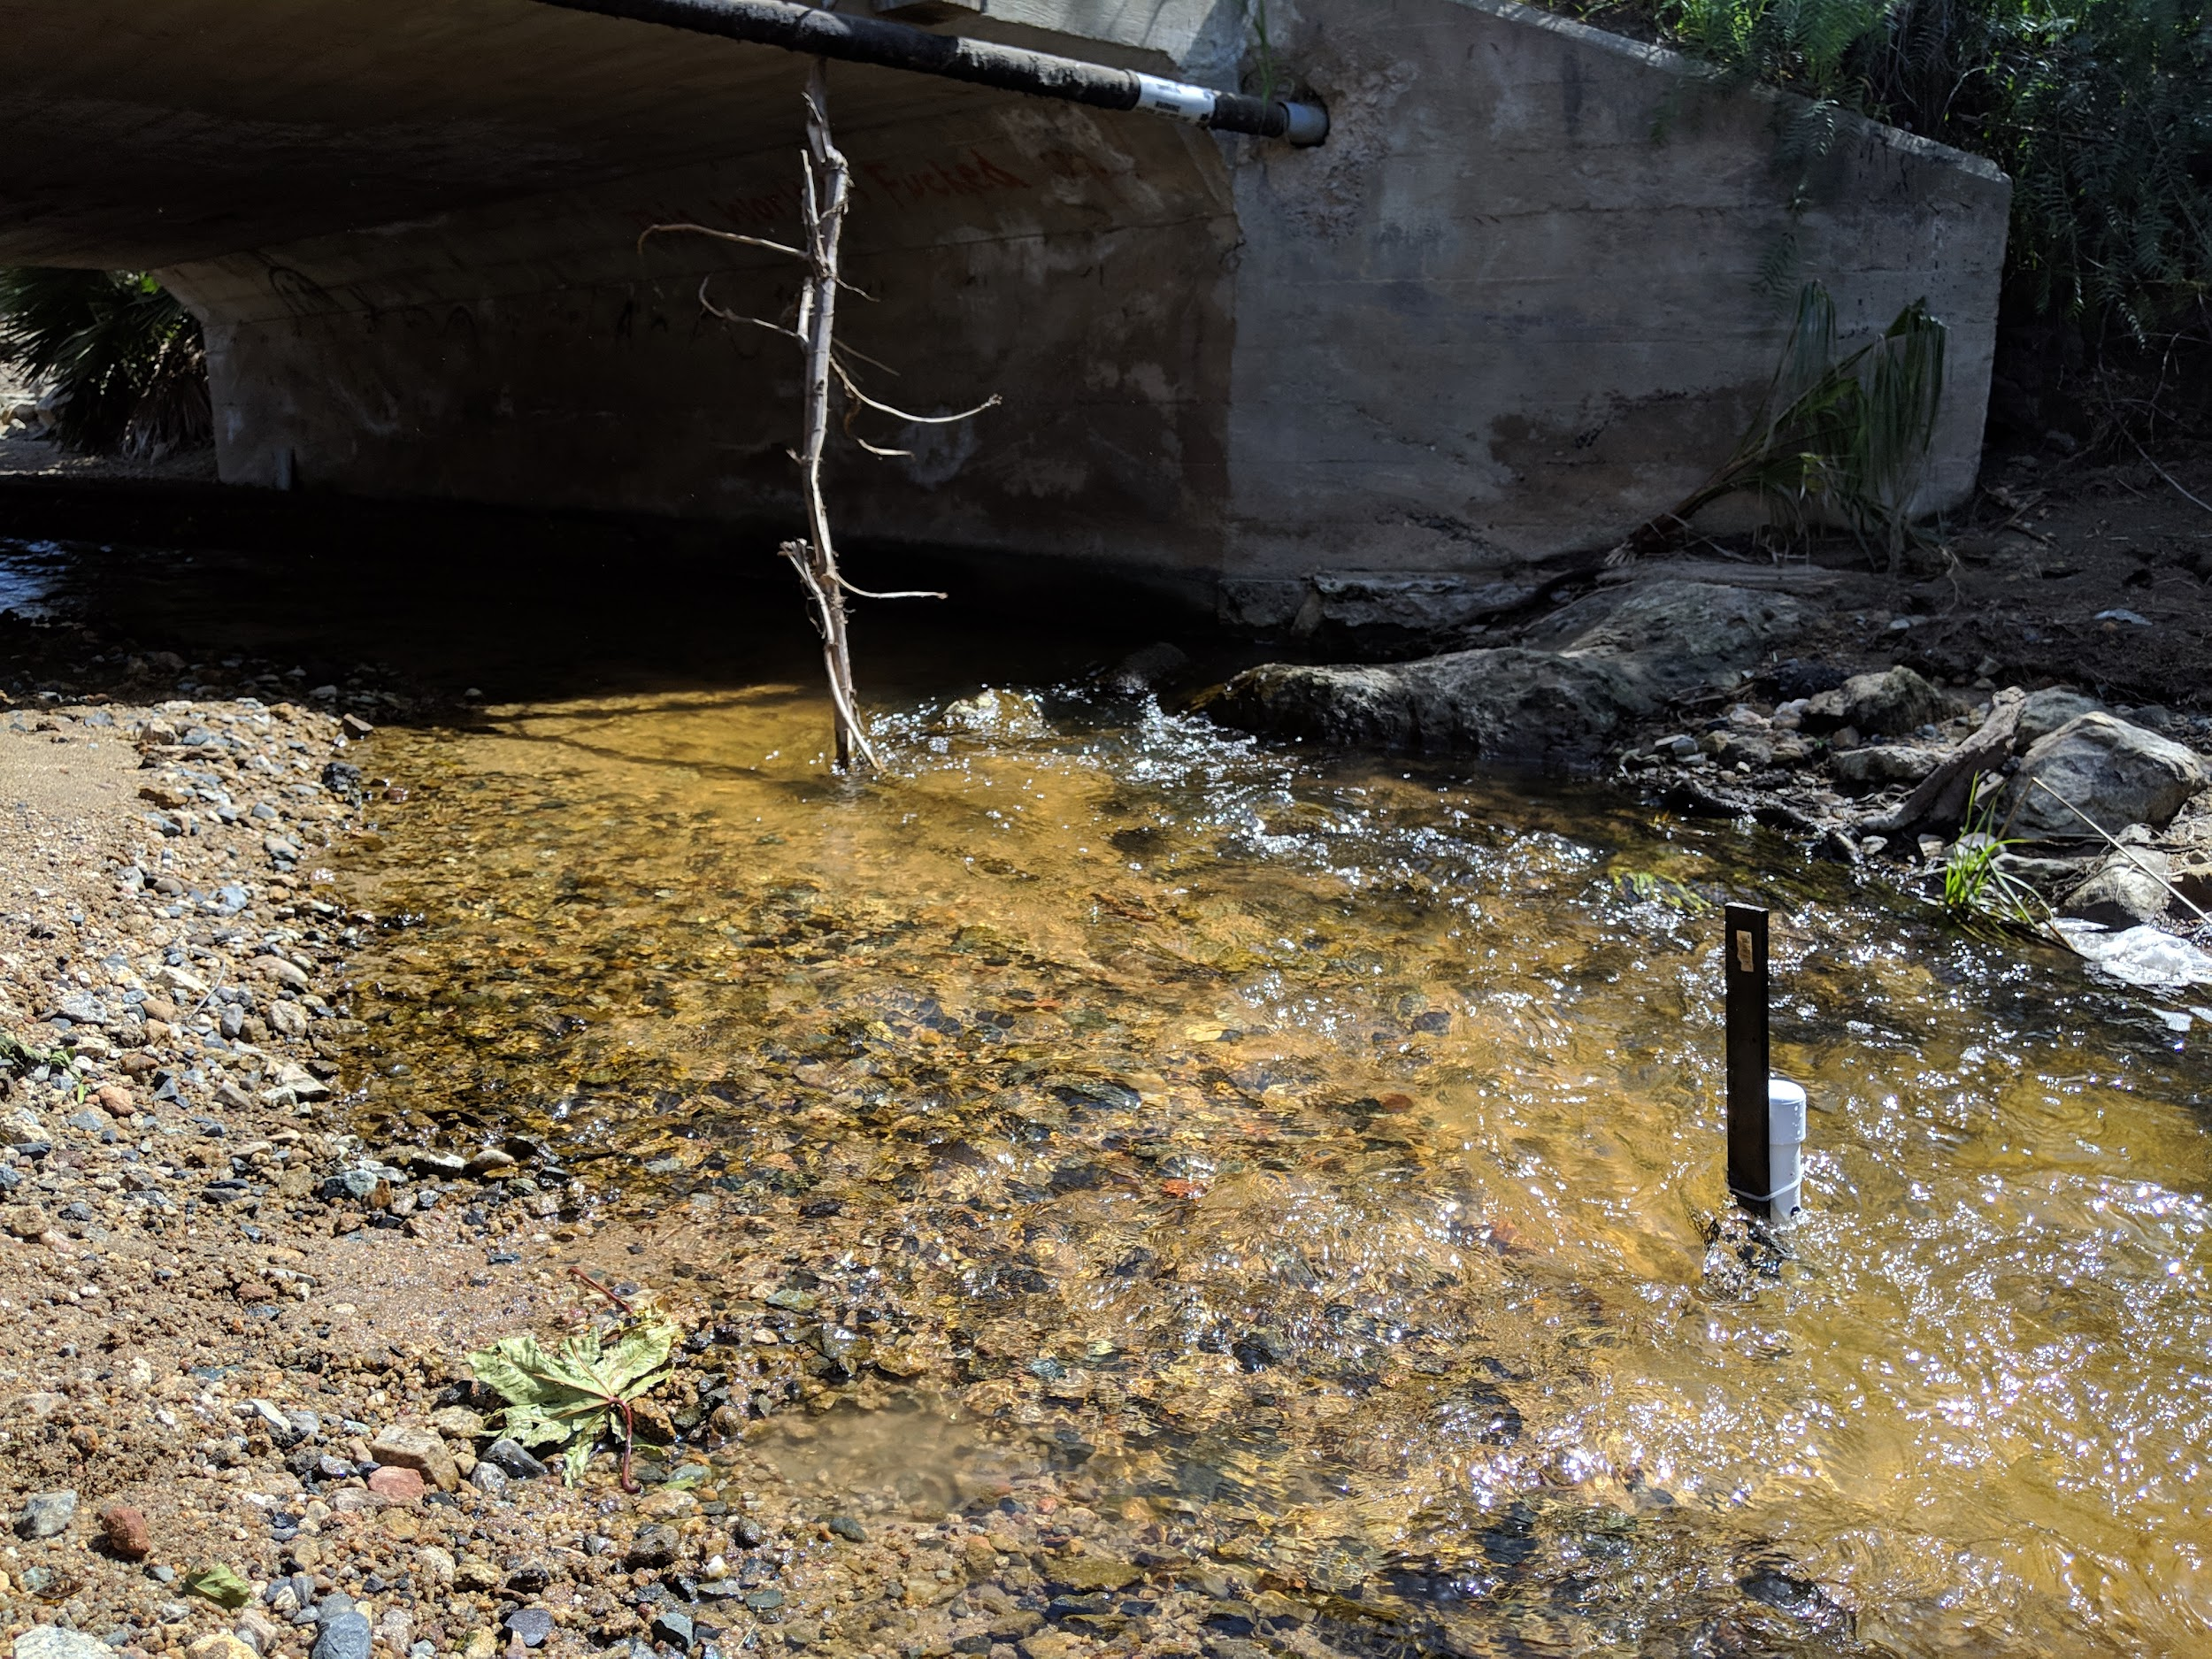
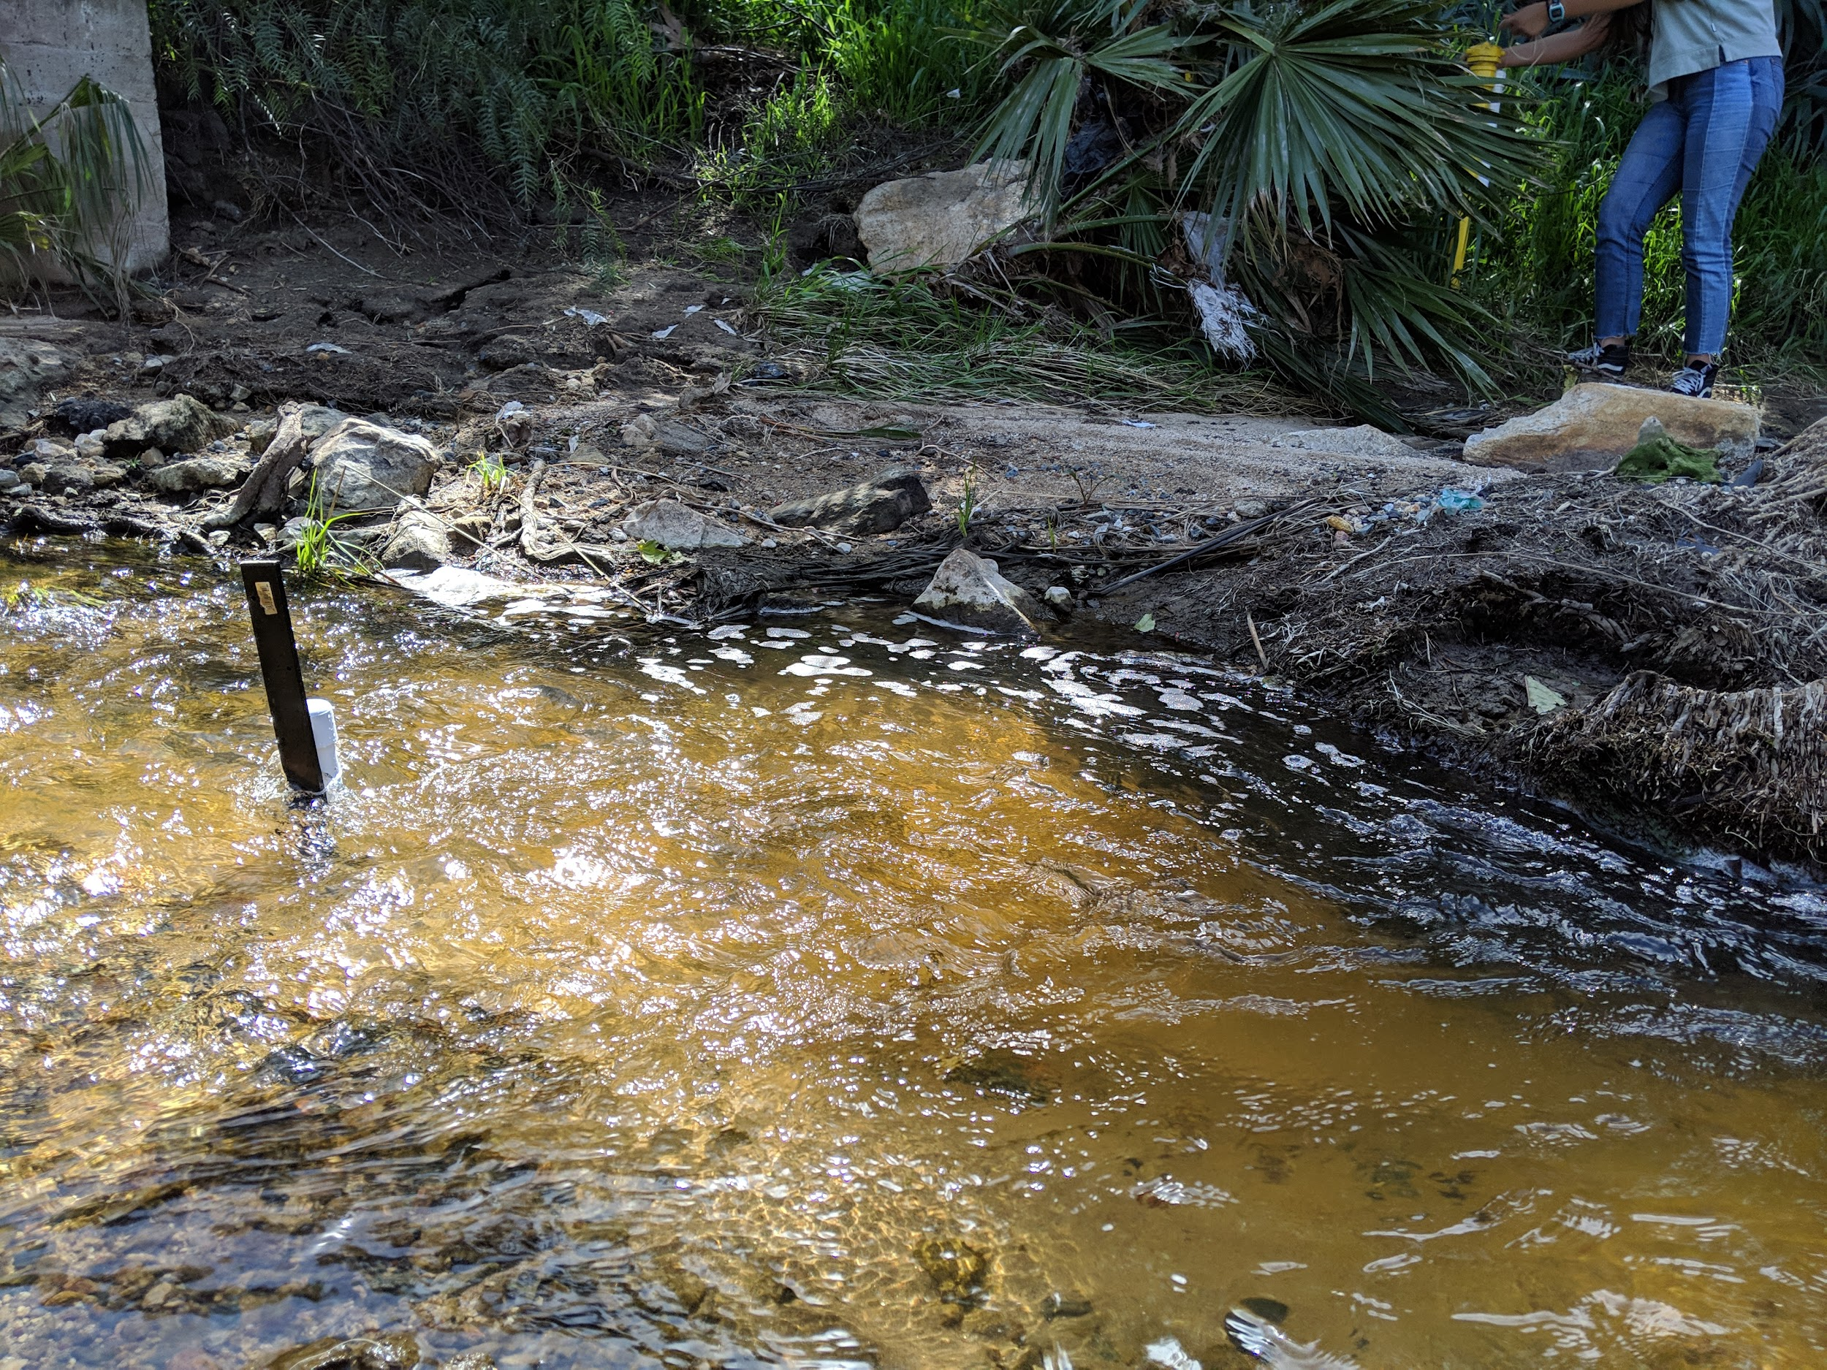
Pressure Transducers 1B & 2B

Slide 10
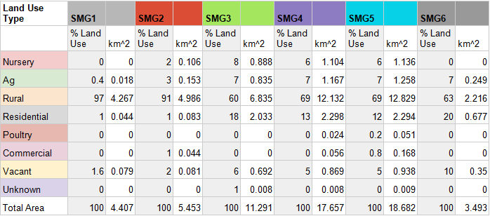
Results - Sampling

Slide 11
Methods
Sample Data Collection

Slide 12
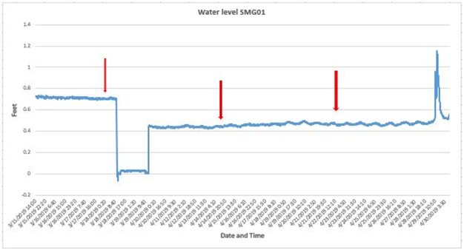
Results - Pressure Transducers
Graph of water level at SMG01 based on corrected data gathered from pressure transducers . The red arrows point to sampling times.

Slide 13
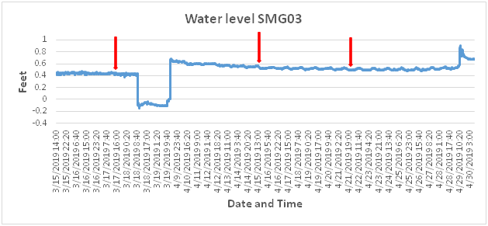
Results- Pressure Transducers
Graph of the water level at SMG02 based on corrected data gathered from pressure transducers with arrows pointing to sampling times.

Slide 14
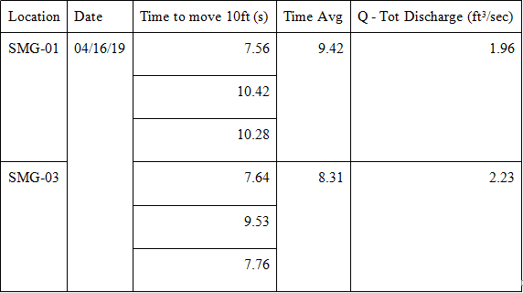
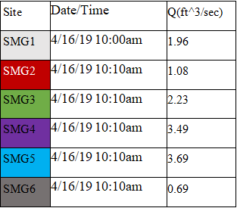
Results - Discharge
Calculated Discharge Rates
Measured Stream discharge rates
Notes:
-Calculated from Q/A

Slide 15
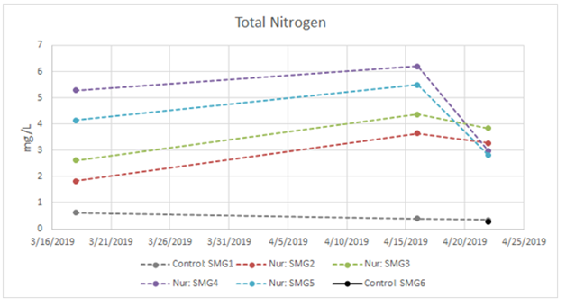
Results- Chemical Analysis
Total nitrogen levels from upstream to downstream over the span of around one month.
Notes:
The increase and sudden drop in total nitrogen at SMG5 (Fig 22) towards the end of the sampling periods could best be attributed to the recession limb hydrologically seen as a slight dip around April 15th to the 20th from a hydrological perspective

Slide 16
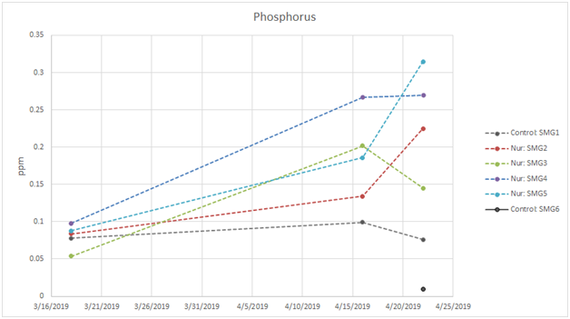
Results - Chemical Analysis
Total inorganic phosphorous at six sampling sites
Notes:
Just like nitrogen concentrations, the level of phosphorus at the upstream value at SMG4, located beneath the cluster of nurseries, is consistently higher than at the downstream sampling point SMG5, except on the last day of sampling, most likely due to stochasticity in hydrologic conditions (Fig 19). The sampling points at SMG2, SMG3, SMG4, and SMG5, all located near nurseries or agricultural land, all have higher concentrations than our controls SMG1, and SMG6, with the exception of SMG3 having a lower amount the first time sampling, most likely due to variations in hydrologic conditions (Fig 4).

Slide 17
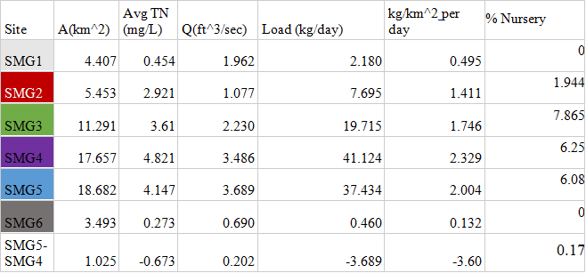
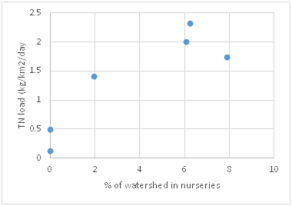
Spatial Analysis
Calculated loads for each sample site
TN load (kg/km2/day) versus the percent of the watershed in nurseries.
Notes:
The percent of the watershed in nurseries correlates with area-normalized nutrient loads.
The loads calculated in Table 14 include the sub-watershed between SMG5 and SMG04. This watershed is the difference between the drainage areas of sample site 5 and sample site 4. Sample site 4 is located directly downstream of the cluster of nurseries (Fig 4). Sample site 5 is located downstream of the nurseries but is separated from the nurseries by a greater distance. The TP and NP concentrations at the site directly beneath the nurseries (SMG4) are consistently higher than that of the site further downstream of them (SMG5). Table 14 illustrates that the nutrient loading and percent nursery decrease from SMG4 to SMG5. The concentrations decrease when there are no additional nurseries in the watershed. This shows that nurseries are directly correlated to the amount of Nitrogen and Phosphorous in the water. The exact reason for the decrease, rather than maintaining the same amount, is not known for certain. We speculate that it could be from dilution do to other tributaries contributing less polluted water or from retention.

Slide 18
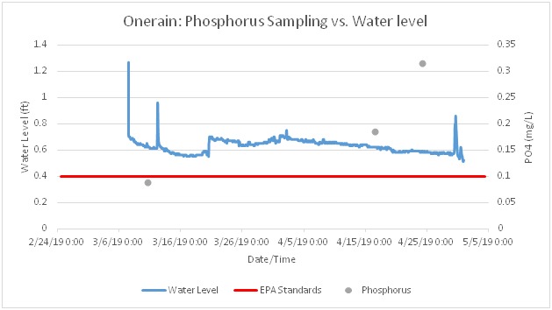
Hydrological & Temporal Analysis
Concentrations of phosphorus displayed over hydrograph at site SMG05

Slide 19
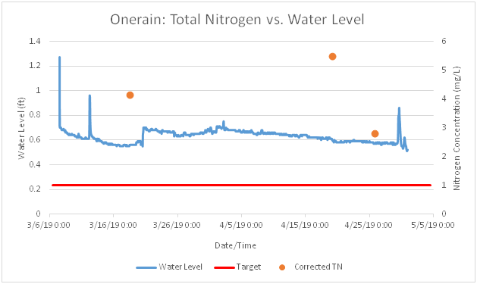
Hydrological & Temporal Analysis
Concentrations of total dissolved nitrogen displayed over hydrograph at site SMG05

Slide 20
Conclusion
TN and TP to be higher than the water quality objectives from 2006 for total nitrogen (1.0mg/L) and phosphorus (0.1mg/L)
TN concentrations downstream of the nurseries/greenhouses were 10x the concentrations upstream (Table#)
Nurseries are directly correlated to the amount of Nitrogen and Phosphorous in the water

